Slide 1
Applied Data Science Capstone Final Presentation
Mohammad Owais Kerney

Slide 2
Agenda
Project Background
1
Data
2
Methodology
3
Results
4
5
Conclusion
2
Notes:
Olga

Slide 3





1.1 Project Background
1. Data Ingestion & Transformation
2. Reporting and Analytics
3. Data and Business Ecosystem
1. The data warehouse is hosted on AWS with a different account
2. Data source is distributed
3. Data needs to be aggregated as business information and insight
An architecture for teams to integrate the services and components across two accounts in AWS
Requirements
Challenges
Solution
Architecture Principles
Cost Efficiency
Performance Efficiency
High Data Availability
Good Maintainability
Least Privilege Security

Slide 4
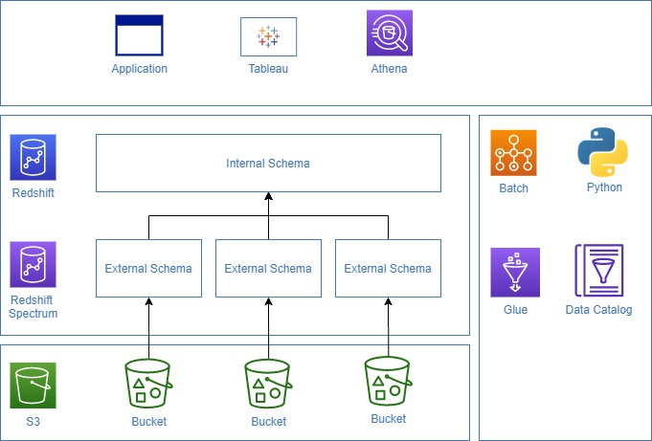
2.1 Redshift Architecture
Requirement
Data from S3 needs to be read into external schema and consolidated in the data model as internal schema
Architecture
Components
1. Bucket
Stores data in parquet file format
2. Data catalog
Defines metadata of data in S3
3. External Schema
Redshift reads the data in S3 via the AWS Glue
4. Internal Schema
Data will be consolidated in the data model for reporting and analytics purposes
5. Python
ETL program used to transform the data from external schema to internal schema
6. Application
Accesses the data in the predefined data model in external schema

